Slide 1


Development of Cooperative
AI Agents for Improving the Efficiency of Household Tasks
Smart Home and Web Services Integration
Kanagawa Institute of Technology
Kota Kawagoe
Notes:
Thank you, Chair, for the kind introduction. Good afternoon, everyone. Today, I would like to share our research on AI Agent Orchestration.

Slide 2
1
Background and Objectives
Research Objectives
• Integrate agents that understand personal context to automate tasks
• Infer user intentions from ambiguous instructions to provide optimal support
Current Challenges
• Smart homes and web services are diverse, but integration is inadequate
• Existing generative AI Agent cannot retain long‑term preferences or context and is weak at interpreting ambiguous instructions
Notes:
Today, we are surrounded by many web services and IoT devices. However, users must learn how to use each device and service, and this creates a high mental load.
Also, many AI agents are now available, but their “memory functions” for remembering past conversations and context are still incomplete.
So, in this research, we aimed to build a system that can perform the best task even from vague instructions by using two types of memory, long-term and short-term, to store data about the user. Long-term memory stores user information that rarely changes, such as addresses and hobbies. Short-term memory stores the user's recent actions.
With this memory, our final goal is to reduce the number of times the user needs to type and to keep the user’s burden as low as possible.

Slide 3






System Overview
2
Central mechanism
Expert Agents
Browser Agent
Web operations & information search
Orchestrator
Maintains long‑term and short‑term memory and supplements context
Decomposes ambiguous utterances into concrete tasks
IoT Agent
Device control & sensors
Lifestyle Agent
Knowledge search & recommendations
Model Context Protocol (MCP)
Standardizes functionalities and connects heterogeneous agents in an extensible manner
Scheduler Agent
Scheduling & reminders
Notes:
This is the overall structure of our system.
It has one central “orchestrator” and four “agents,” each specialized for a specific function.
The user gives instructions only to the orchestrator.
Based on the user’s instruction, the orchestrator assigns tasks to the right agents according to each agent’s strengths.
To connect these agents, we use “MCP (Model Context Protocol),” developed by Anthropic.
This is a connection protocol that is becoming a standard in recent AI agent development.

Slide 4
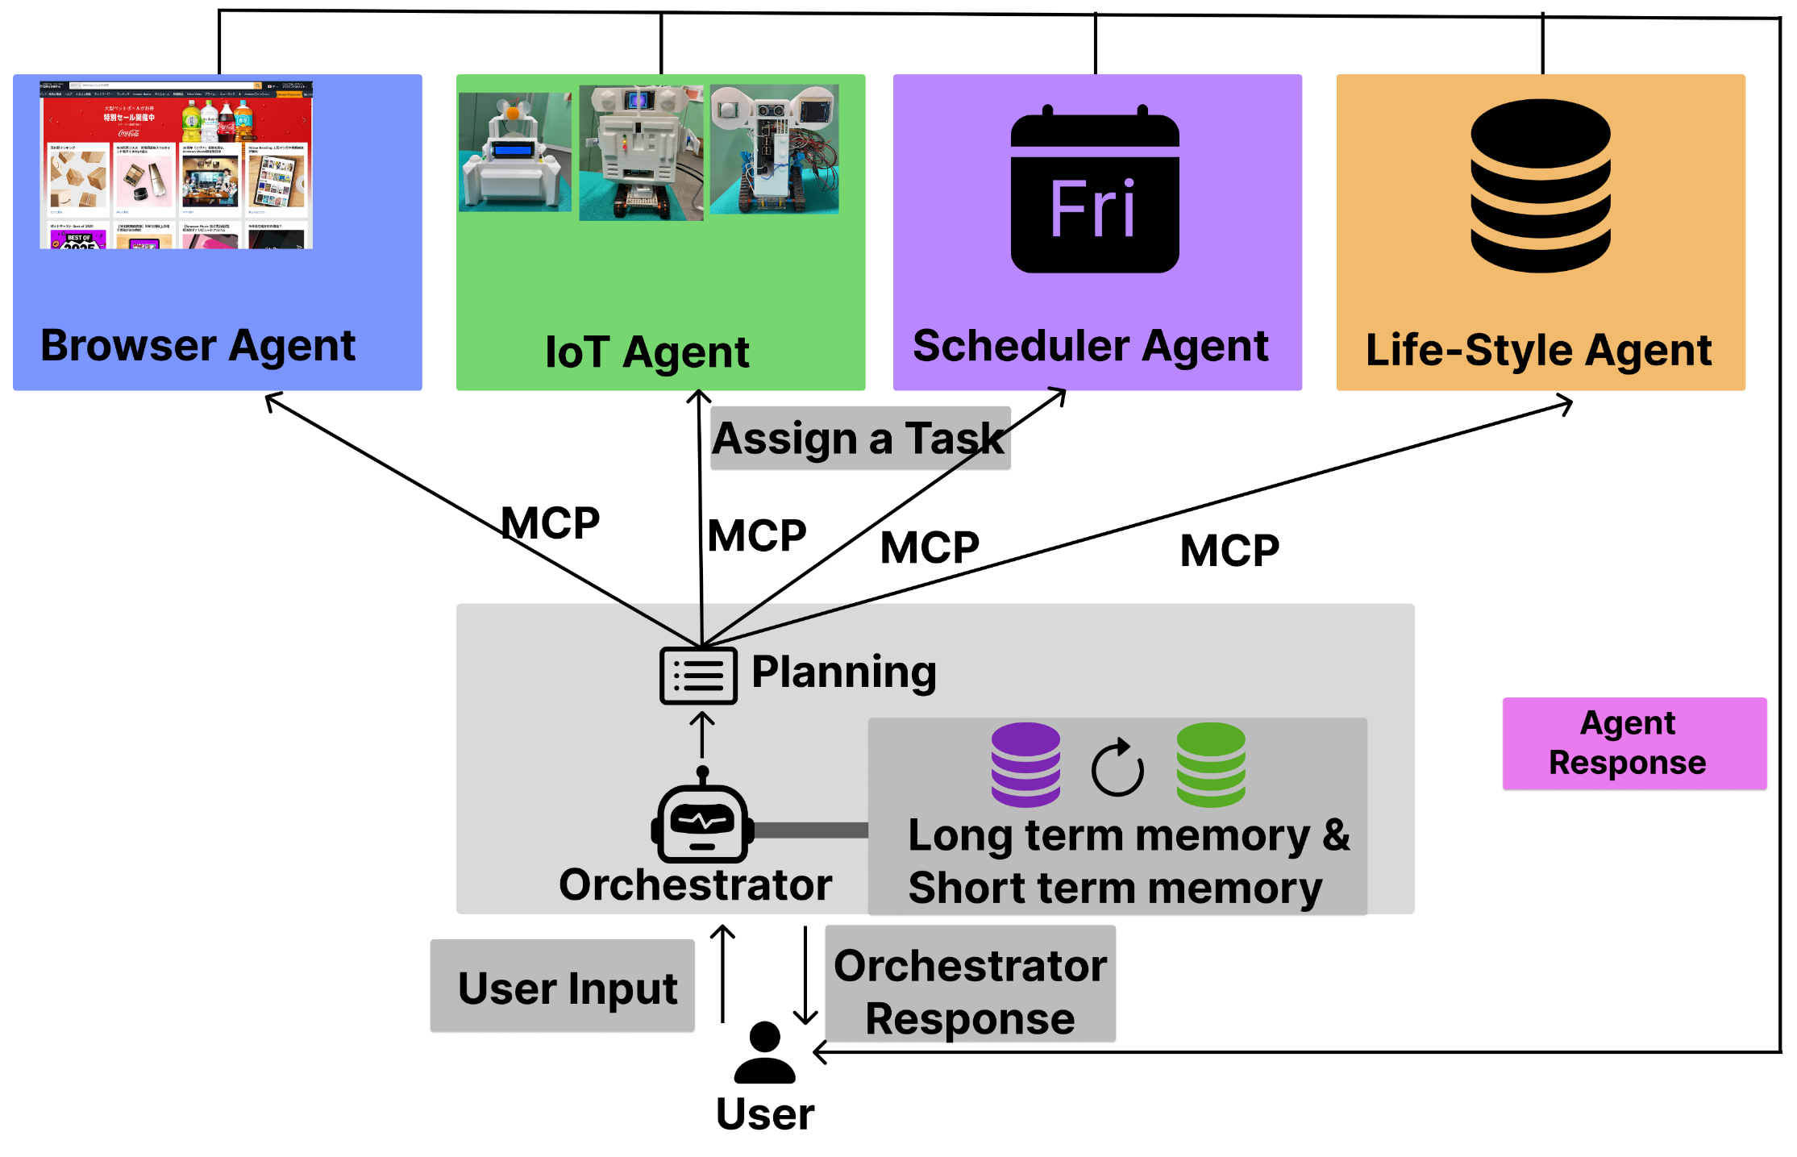
Architecture and Memory Mechanism
3
Notes:
First, please look at the overall system.

Slide 5
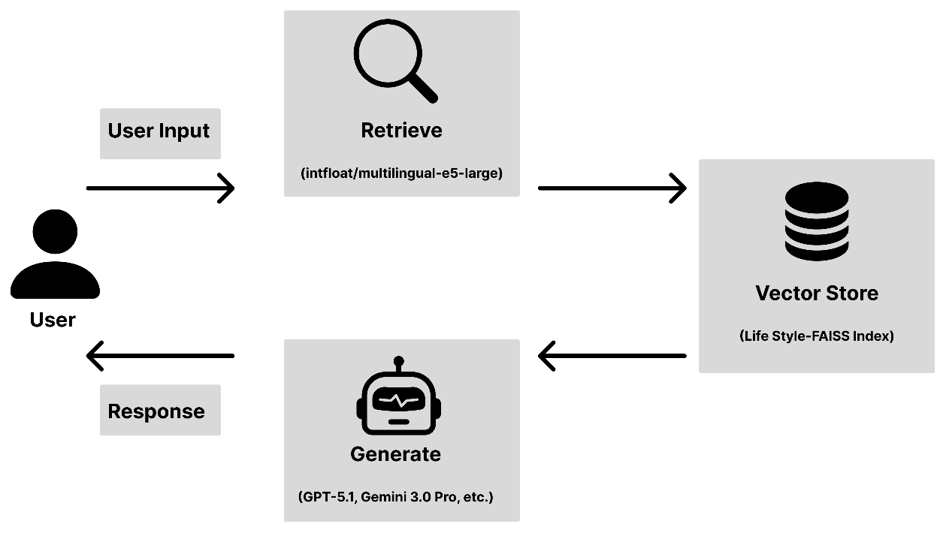
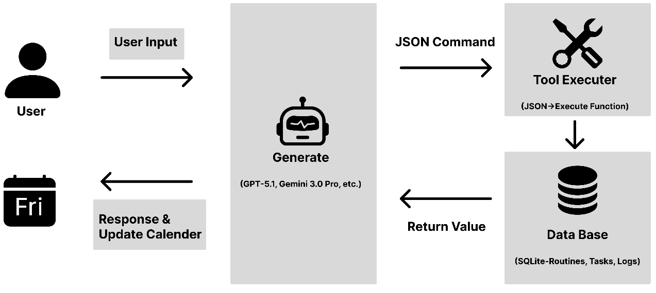
4
Life-Style Agent
Scheduler Agent
FAISS(Facebook AI Similarity Search)
Local vector store for fast similarity search
Embeddings
multilingual-e5-large for accurate multilingual (incl. Japanese) semantic search
Function Calling
Tools defined with JSON Schema
SQLAlchemy
Python-controlled access to relational data
Notes:
Now I will explain the technical details of each agent.
First, the “Life-style Agent” is a chat system using RAG (Retrieval-Augmented Generation).
We converted Q&A data about useful household information into a vector database, and we use FAISS (Facebook AI Similarity Search) for similarity matching.
For the embedding model, we use multilingual-e5-large.
Next is the “Scheduler Agent.”
This agent is specialized for calendar operations. Using Function Calling, it updates the database from the LLM output and performs actions such as adding or deleting schedules.

Slide 6
Architecture of the Life-Style Agent​
5
Notes:
This is the overall architecture of the Life-style Agent.

Slide 7
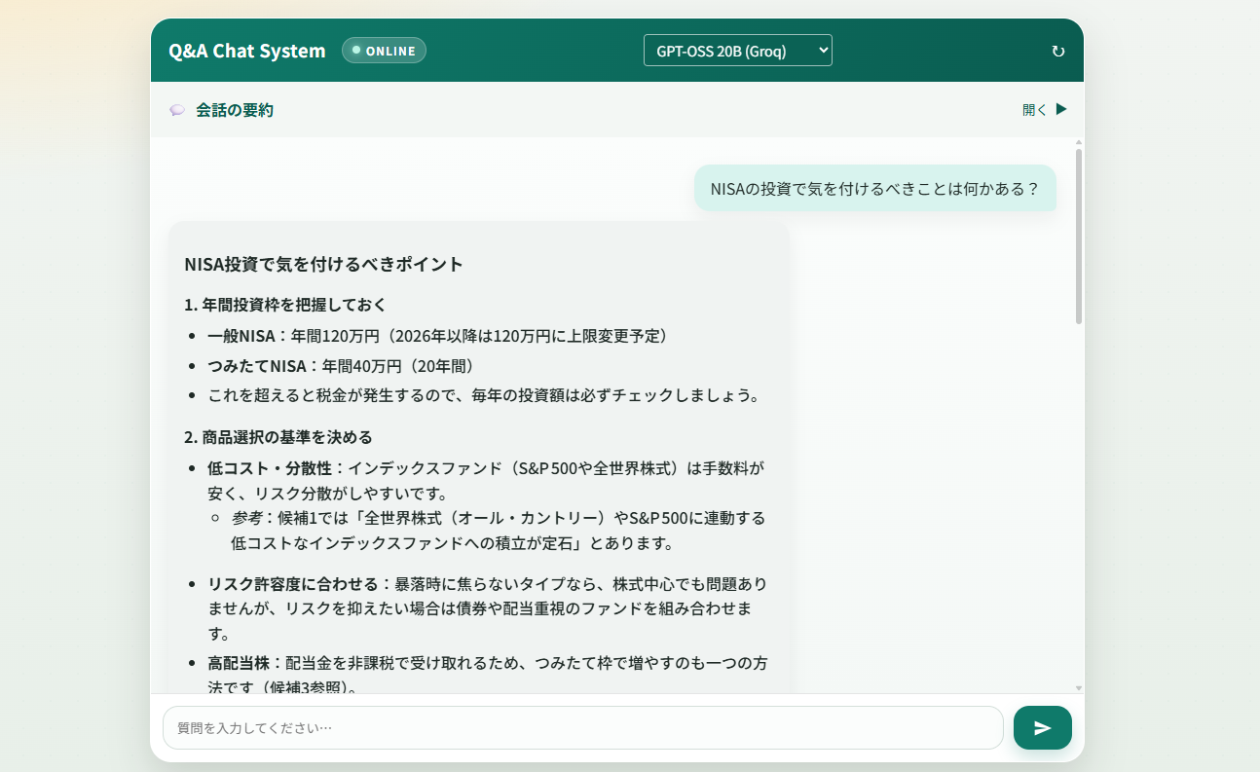
Lify-Style Agent
6
I'd like some suggestions for tonight's dinner menu.
Notes:
Here is an actual example of how it works.
The prompt is: “I'd like some suggestions for tonight's dinner menu.”
For this vague user request, the agent gives an answer based on the database.

Slide 8
7
Architecture of the Scheduler Agent​
Notes:
Next, this is the architecture of the Scheduler Agent.

Slide 9
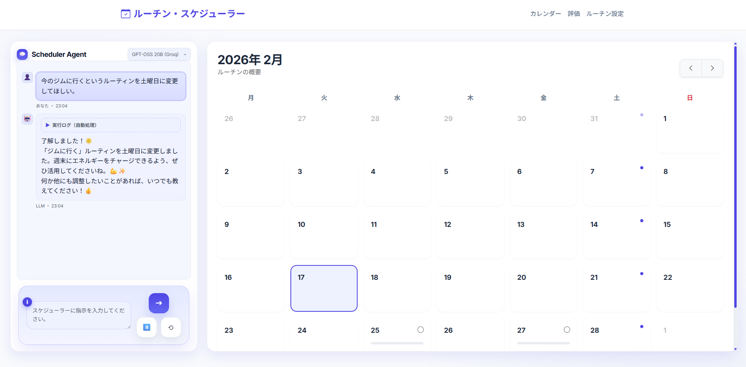
Scheduler Agent
Make plans for dinner tonight at 8pm.
8
Notes:
This is an example of the Scheduler Agent in action.
The prompt is: “Make plans for dinner tonight at 8pm.”
As you can see, the schedule is added correctly as instructed.

Slide 10
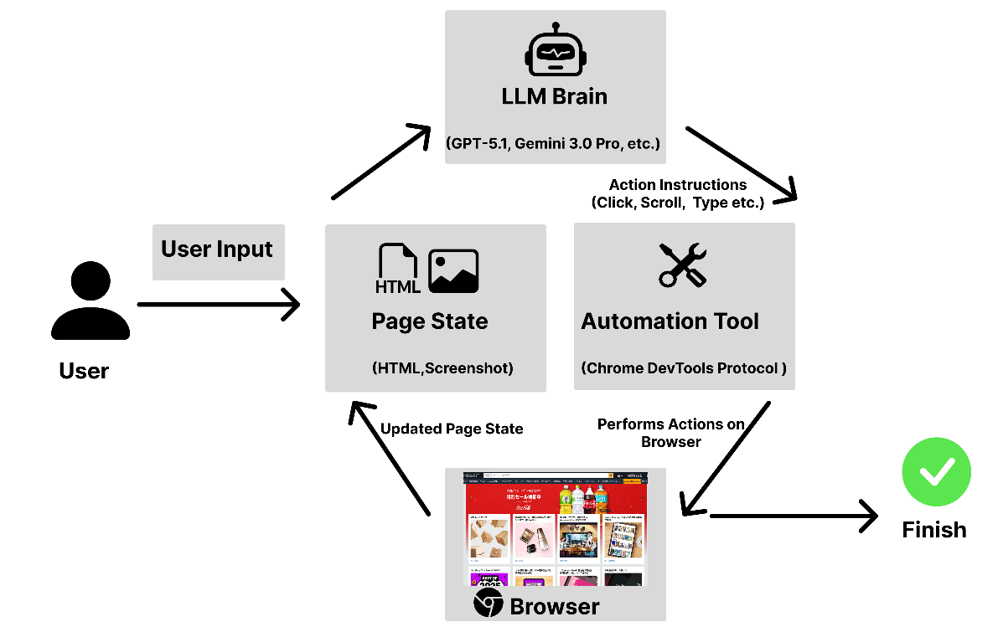
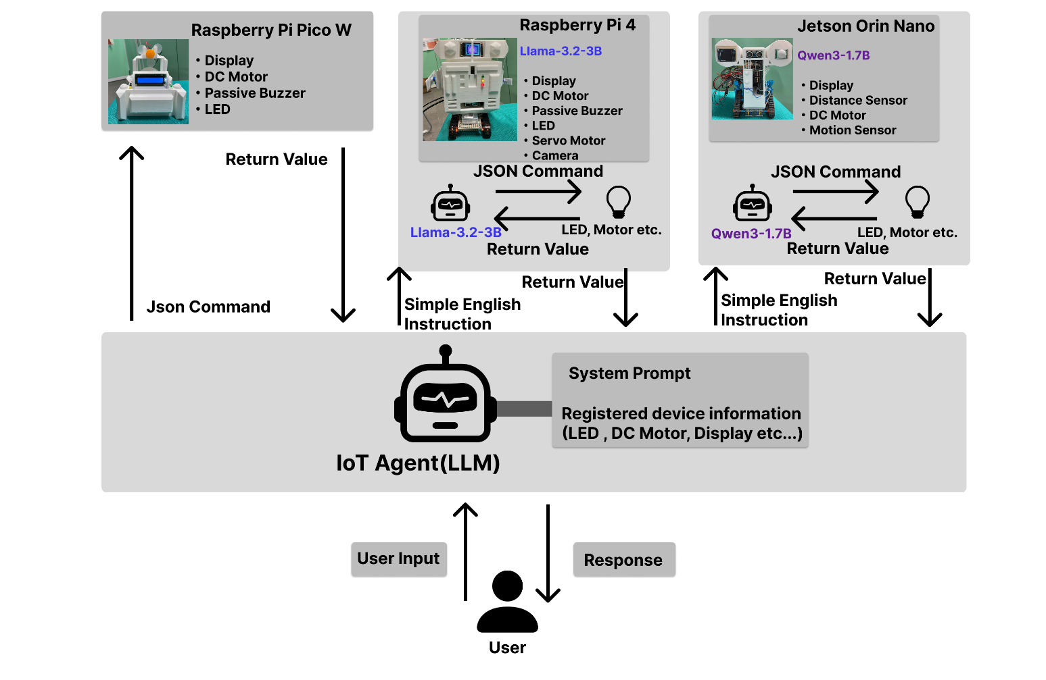
9
Browser Agent
IoT Agent
MicroPython
Lightweight Python running on Raspberry Pi Pico W, enabling simple hardware control.
Llama‑cpp‑python
Executes quantized models (gguf files) running on edge devices.
Browser‑use
A web page manipulation library using an LLM. It extracts and streamlines reactive elements in the 'observe–think–act' loop.
Notes:
The “Browser Agent” uses the open-source browser-use library.
Using an “observe–think–act” loop, the LLM gets information from websites and repeats actions until the task is completed or judged impossible.
The “IoT Agent” has two execution flows.
One is a pattern where the cloud LLM directly outputs commands and executes them.
The other is a pattern where the cloud LLM changes the user’s instruction into simple English instructions and sends them to the device, and then a local LLM on the device interprets them and executes the commands.

Slide 11
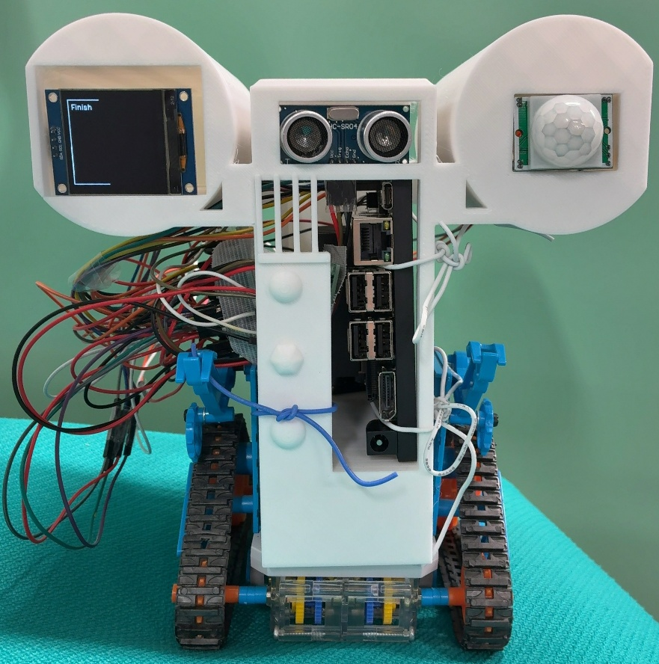
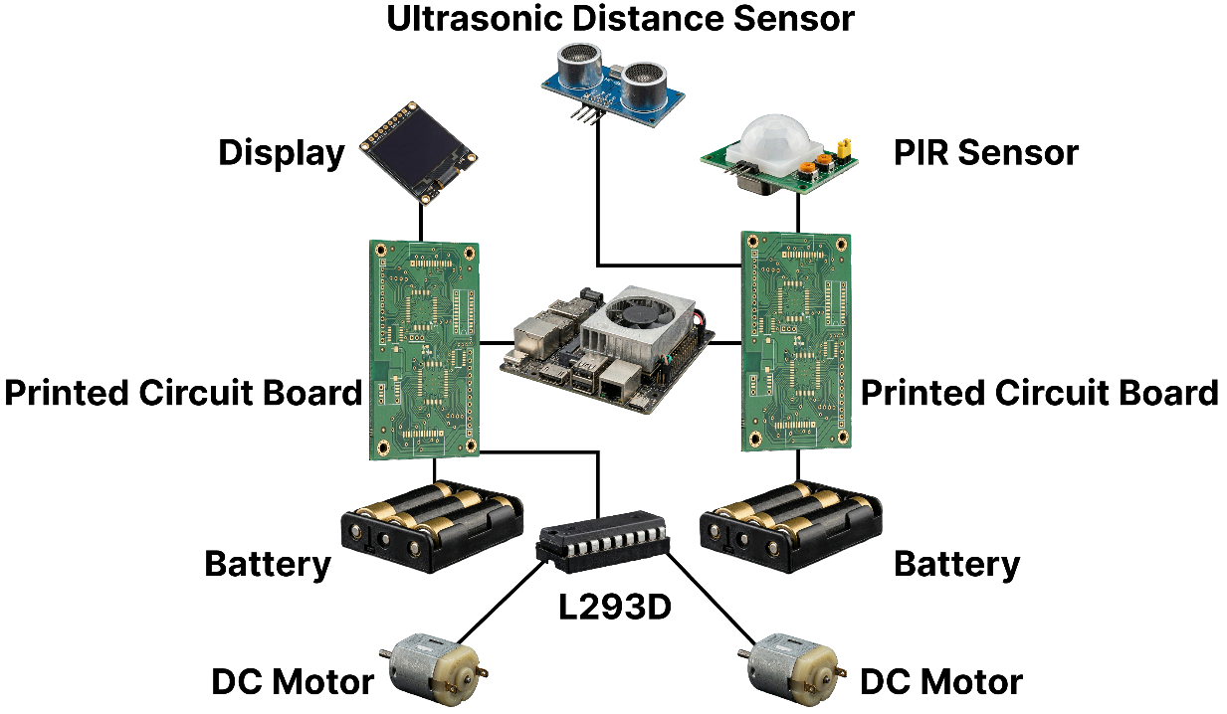
Examples of IoT Devices
10
Notes:
This is an example of the IoT device hardware setup.
At the center is a single-board computer such as Jetson Orin Nano, and various sensors and actuators are connected to it.

Slide 12
Architecture of the IoT Agent
11
Notes:
This is the detailed architecture of the IoT Agent.
We use different methods depending on the device’s processing power.
As mentioned earlier, on Raspberry Pi Pico W, the device directly executes commands from the cloud LLM.
On the other hand, on higher-performance devices such as Raspberry Pi 4 and Jetson Orin Nano, a local LLM such as Llama 3.2 or Qwen 3 interprets the received instructions and executes them.

Slide 13
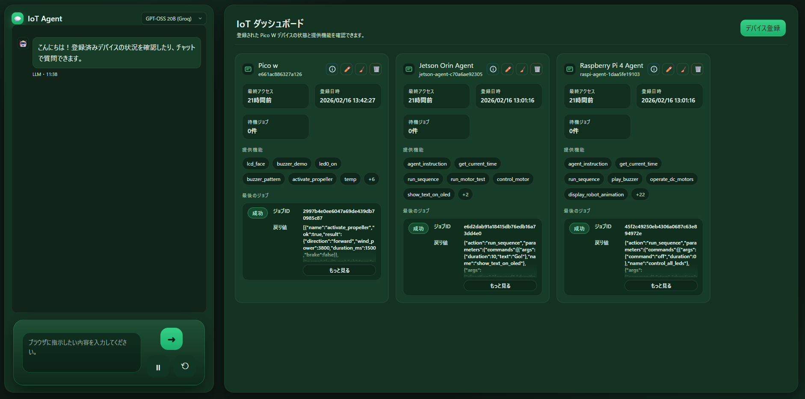
IoT Agent
12
After moving forward for 5 seconds, turn on the LED.
Notes:
This is a real device example of the IoT Agent.
The prompt is: “After moving forward for 5 seconds, turn on the LED.”
A combined action—movement and turning on the LED—is executed.

Slide 14

Architecture of the Browser Agent
13
Notes:
This is the architecture of the Browser Agent.

Slide 15
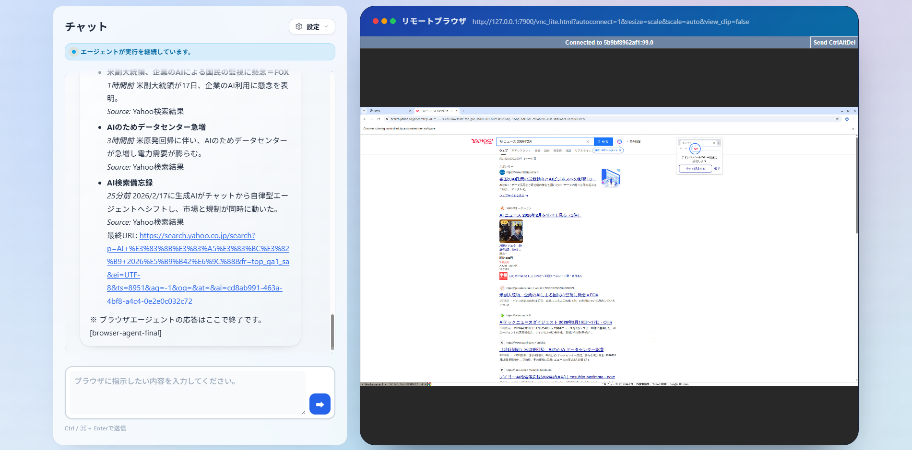
Browser Agent
Please tell me five AI-related news stories that happened in the past week.
14
Notes:
This is an example of the Browser Agent in action.
The prompt is: “Please tell me five AI-related news stories that happened in the past week.”
It gets the latest information from the web and presents it.

Slide 16

Technologies Used in the
Orchestrator and Memory Updating
15
Orchestrator
Memory
LangGraph
Used for controlling flow among agents, managing state, and branching/merging tasks.
LangChain
Used as an interface for interacting with the LLM (large language model).
MCP
Adopted as the connection interface when calling external agents.
Structured JSON
Manage short-term memory + long-term memory with two json files
LLM Integration
Generate and update based on chat history
Semantic Diffing
Updates only changes, prevents duplicates
Notes:
This is the mechanism of the orchestrator, which is the core of our system.
We use LangGraph to modularize the planning, execution, and evaluation cycles, and LangChain to manage different LLM providers. As mentioned earlier, agents communicate through MCP, making the system highly scalable.
For memory management, we use a JSON file.
The LLM updates its contents every 10 conversational turns. Crucially, instead of outputting the entire memory every time, the LLM outputs only the "differences" or "deltas."
This algorithm prevents information loss, minimizes token consumption, and optimizes the context window. Through this efficient memory update, the system successfully personalizes its behavior for each user.

Slide 17

Architecture and Memory Mechanism
16
Notes:
This is the architecture diagram of the whole system.
You can see that the orchestrator sends task instructions to each agent through MCP.

Slide 18
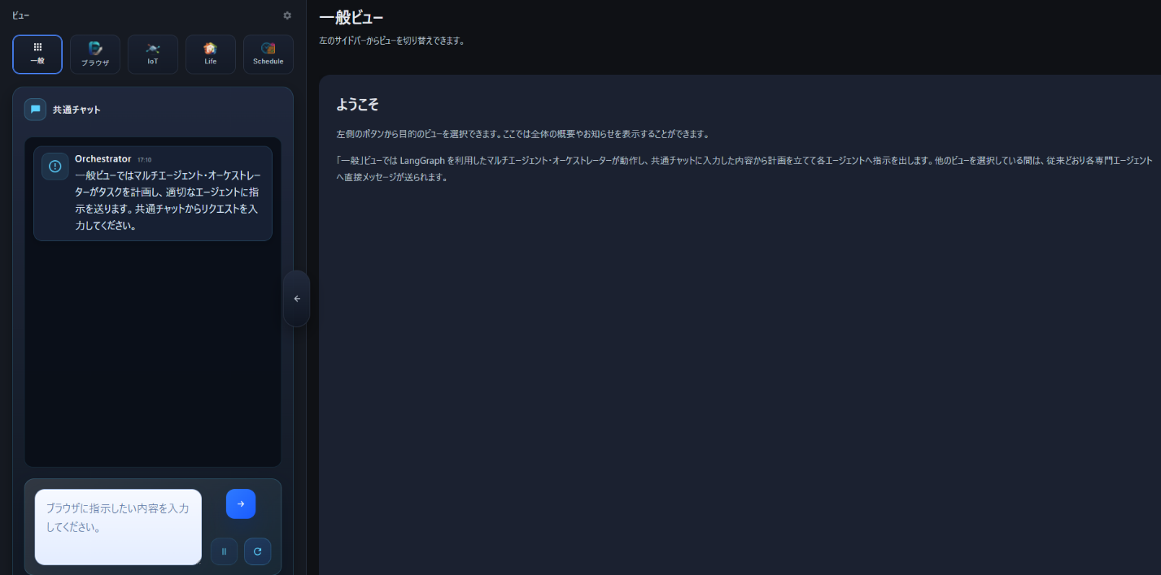
Orchestrator
After researching today’s weather in Hon-Atsugi, add it to today's notes and display the contents on the screen.
17
1. Browser Agent
2. Scheduler Agent
3. IoT Agent
Notes:
This is an example where the orchestrator coordinates multiple agents (Browser, Scheduler, IoT, and Life-Style).
The prompt is: “After researching today’s weather, add it to today's notes and display the contents on the screen.”
First, the Browser Agent gets the weather.
Next, the Scheduler Agent saves that information in the notes.
Finally, the IoT Agent displays it on the screen.
We can confirm that information is passed correctly between the agents.

Slide 19
Operation of the Orchestrator
18
User Input
Long‑Term Memory
Address & Hobbies
End
Short‑Term Memory
Recent Context
Plan
Execute
(Each Agents)
Review
Personalized memory: Long-term + Short-term context for intent
Agent execution: Call & supervise specialized agents via MCP
Review loop: Validate results and retry when needed
Notes:
This is the internal flow of the orchestrator.
In addition to the user input, short-term memory and long-term memory are combined and given to the agents as input.
Based on that, the system runs a loop of “plan, execute, and evaluate.”
This loop continues until the task is completed or judged impossible to execute.

Slide 20
Evaluation Design
19
Evaluation Scenarios (10 cases)
Prepared 10 scenarios that require collaboration across multiple agents, such as Ambiguous instruction → Web search → Lifestyle support response
→ Schedule registration → IoT notification.
Task example:
"I wonder if there's a shop nearby that has my favorite food. If there is, add it to today's notes and then display the store's name on the display."
• Criterion 1: Whether a search related to the user's preference (favorite food) was performed.
• Criterion 2: Whether it was recorded in the notes.
• Criterion 3: Whether the store's name could be displayed on the display.
Notes:
Now I will explain the evaluation experiment.
We tested the performance difference with and without user memory.
For the experiment, we prepared 10 virtual tasks, ranging from tasks that can be handled by a single agent to tasks that use all four agents.
This lets us measure how much the system can reduce the user’s burden in daily tasks.
An example task is:
“I wonder if there's a shop nearby that has my favorite food. If there is, add it to today's notes and then display the store's name on the screen.”
We evaluated the system based on three criteria:
First, did it search for the user's favorite food?
Second, was the information recorded in the notes?
And third, could it show the store's name on the screen?

Slide 21
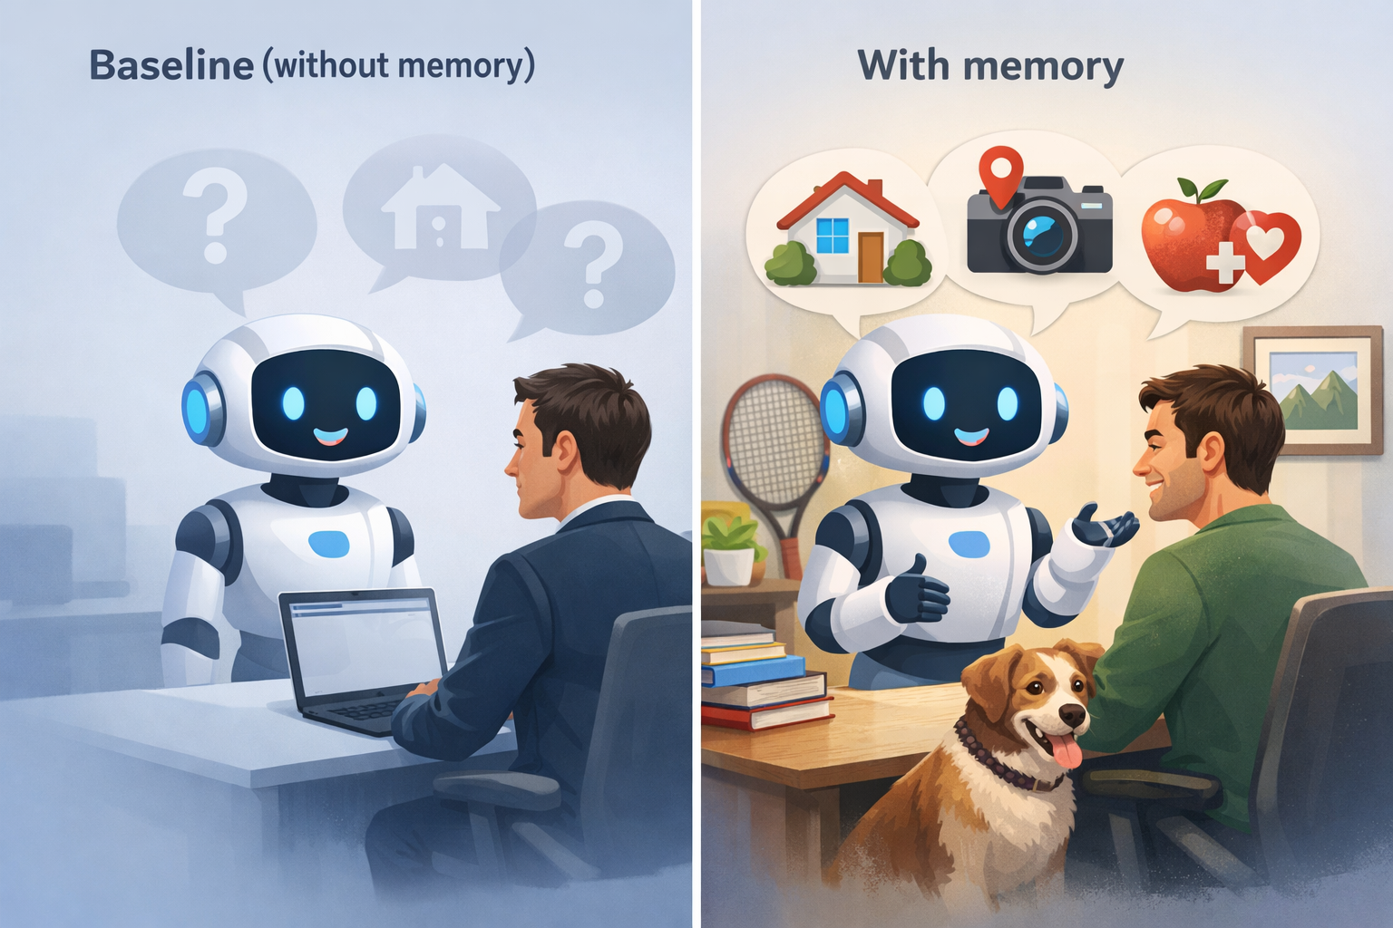
20
Evaluation Metrics
Baseline (without memory)
A state that retains no personal information
With memory (fictitious data for evaluation)
A state that behaves according to personal data such as address, hobbies and health condition
Notes:
As a baseline, we compared an agent “without memory” and an agent “with memory” that stores a persona such as a virtual address and hobbies.
We evaluated which one could process tasks more efficiently and with a higher success rate.

Slide 22
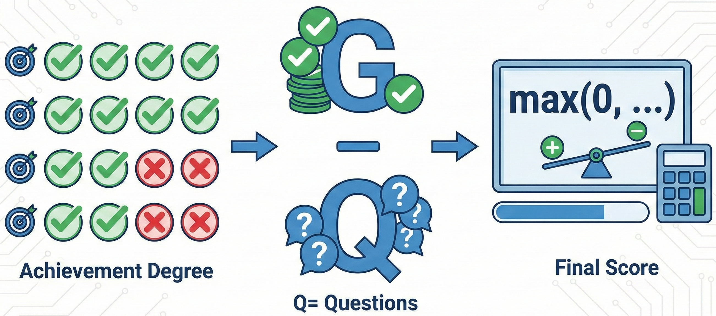
Experimental Conditions
21
Achievement Degree + Question Penalty
Set multiple sub‑goals (criteria) for each scenario and determine success (○) or failure (×) for each criterion
Score
G = number of successes, Q = number of questions asked (times additional information is requested from the user)
Score = max(0, G − Q) (user burden, i.e., questions, is treated as a deduction)
Notes:
This is our scoring rule. For multiple evaluation items within a single task, we judge each item as a simple correct or incorrect.
However, a key feature of our evaluation is how we measure user burden. Every time the agent asks the user a question to clarify vague instructions, we subtract 1 point.
In AI agent systems, requiring frequent human intervention increases the "Interaction Cost" and defeats the purpose of autonomy.
Therefore, we treat this as a strict penalty. The final score is calculated as the number of successful items minus the number of clarification questions asked.

Slide 23
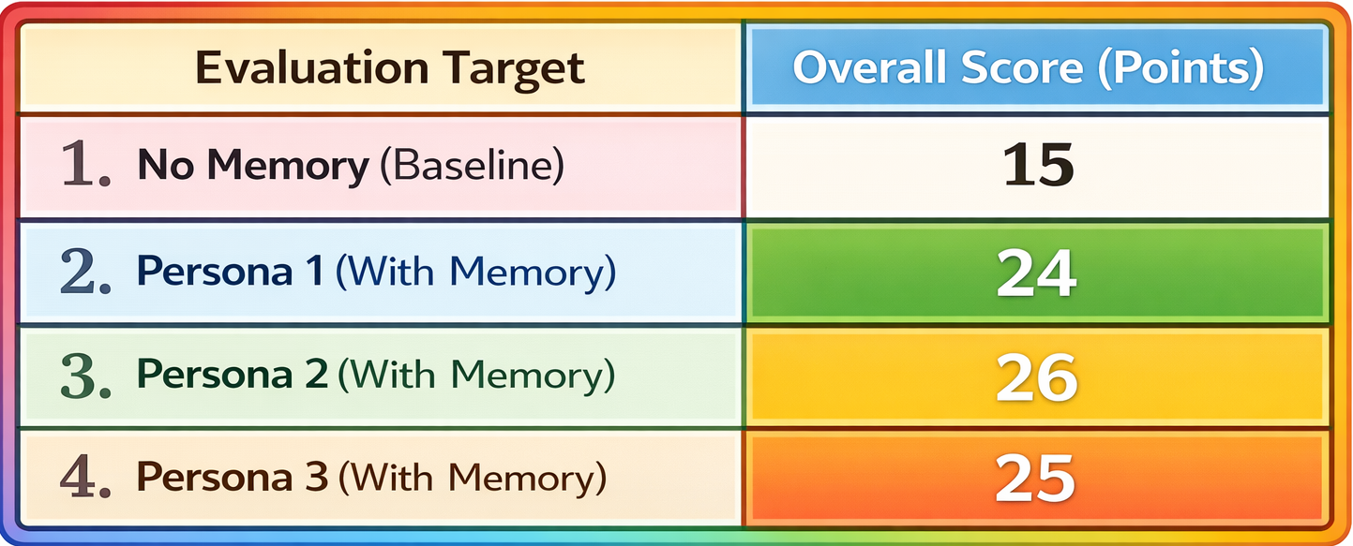
22
Evaluation Results Without and With Memory
Notes:
As a result of the experiment, the baseline without memory scored 15 points, while the case with memory scored an average of 25 points.

Slide 24


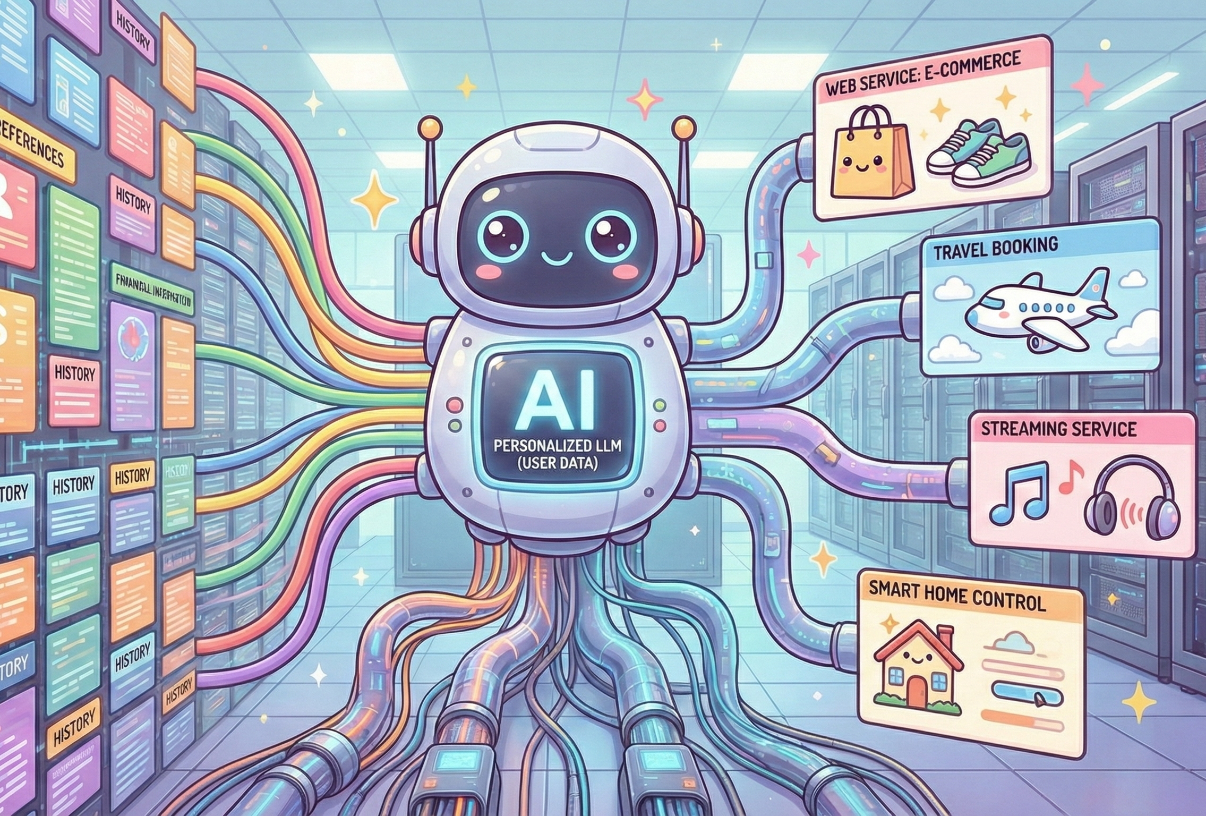
Results
23
Effects of the Memory Mechanism
• Task completion rate improved 1.7 times and confirmation questions became unnecessary.
• Personalization became possible based on user attributes and history.
Notes:
By using memory, the task success rate improved by about 1.7 times.
By letting agents refer to and share personal data such as address and hobbies, task execution became much more efficient.
This also shows that, even in a multi-agent system, passing information through the orchestrator works effectively.

Slide 25


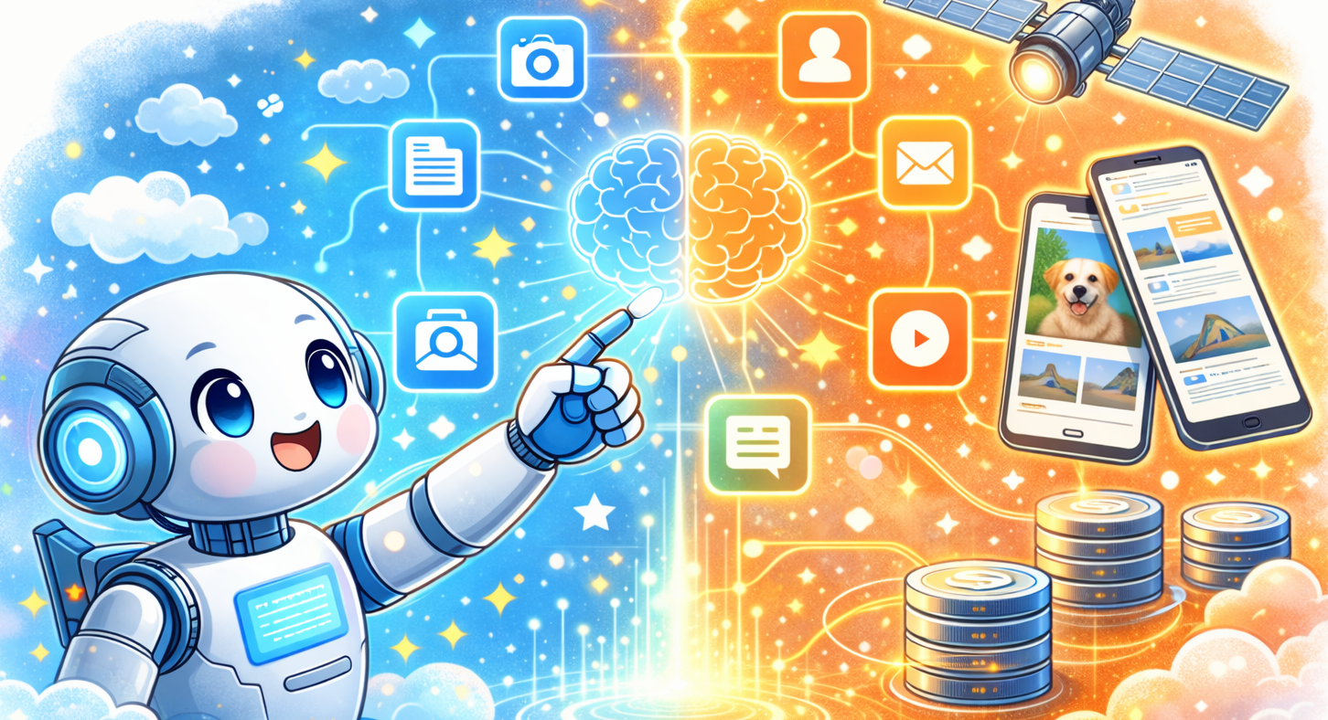
Challenges
24
• Errors in time perception remain due to the knowledge cutoff of the LLM.
• Introducing multimodal models and real‑time RAG is a future challenge.
Remaining Challenges
Notes:
Finally, I will discuss current issues and future work. Currently, the Browser and Scheduler agents sometimes misinterpret dates and times.
This happens because the LLM relies on outdated training data, or makes calculation errors when reasoning about relative dates like "next Wednesday."
We plan to solve this by emphasizing temporal context in the system prompts and providing dedicated calculator tools.
Regarding the system evaluation, our current experiment used 10 virtual tasks. In the future, we need to test the system on standardized multi-agent benchmarks to ensure objective performance measurement.
We are also considering using an "LLM-as-a-Judge" approach for more scalable and automated evaluation. Lastly, supporting multimodal inputs, such as images and audio, will enable even more advanced and accurate autonomous execution.

